Slide 1


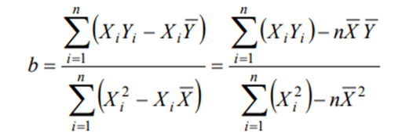
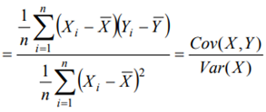


Slide 2
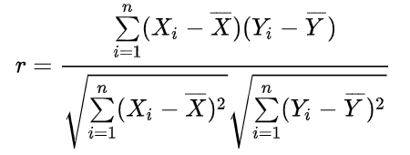


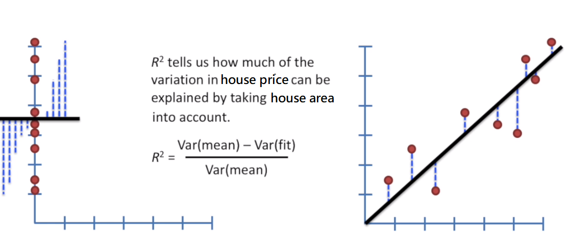
Correlations and Relationships
Correlation coefficient
Two variable x and y, correlation coefficient ( r ) is defined as

Slide 3


